Slide 1
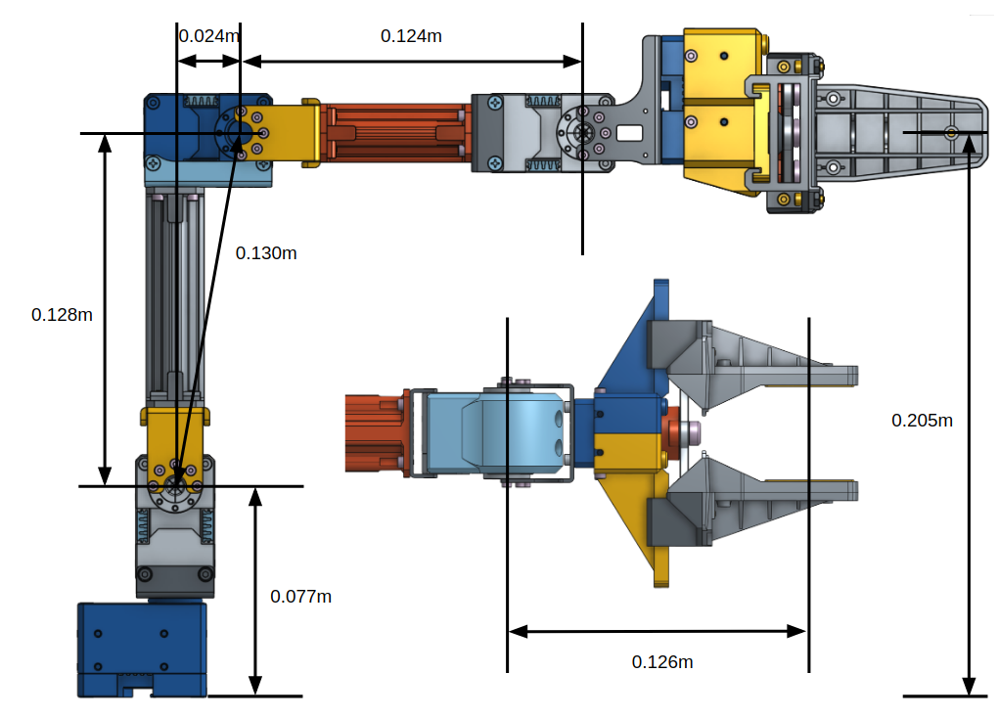

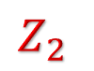
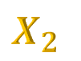



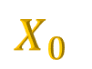
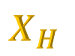

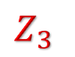
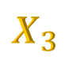
$$X_{2}$$
$$X_{3}$$
$$X_{H}$$
$$Z_{2}$$
$$Z_{3}$$
$$Z_{H}$$
$$X_{1}$$
$$Z_{1}$$
$$Z_{0}$$
$$X_{0}$$

Slide 2
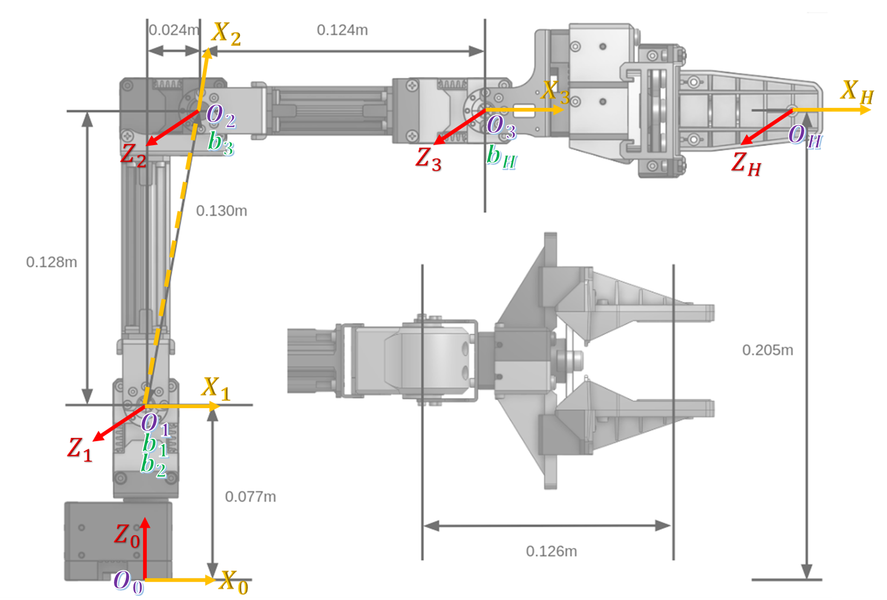

Slide 3
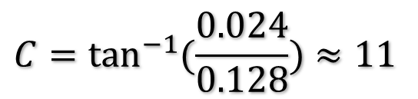
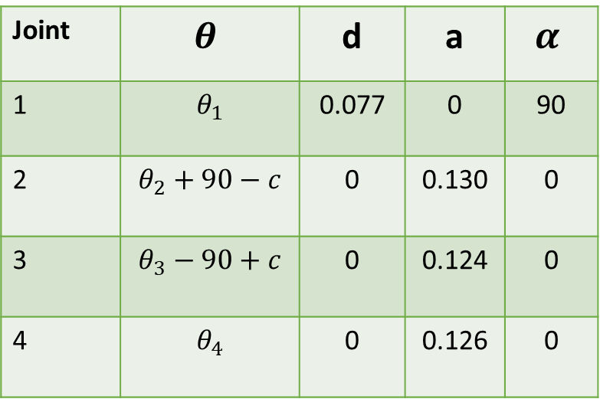
DH parameters:
Joint | $$θ$$ | d | a | $$α$$
1 | $$θ_{1}$$ | 0.077 | 0 | 90
2 | $$θ_{2}+90−c$$ | 0 | 0.130 | 0
3 | $$θ_{3}−90+c$$ | 0 | 0.124 | 0
4 | $$θ_{4}$$ | 0 | 0.126 | 0
-
-
-
$$C=\tan^{−1}{(\frac{0.024}{0.128})}≈11$$

